Slide 1
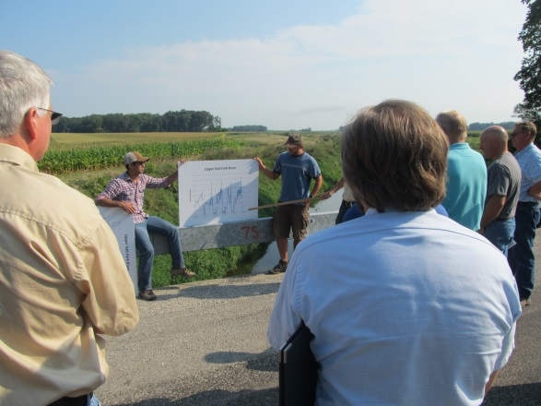
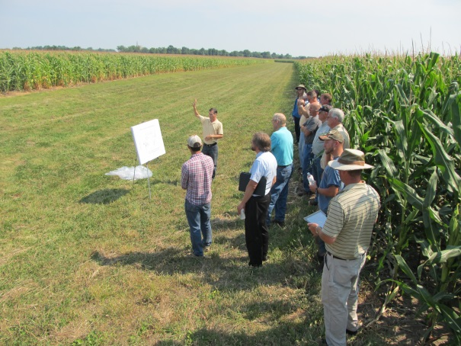
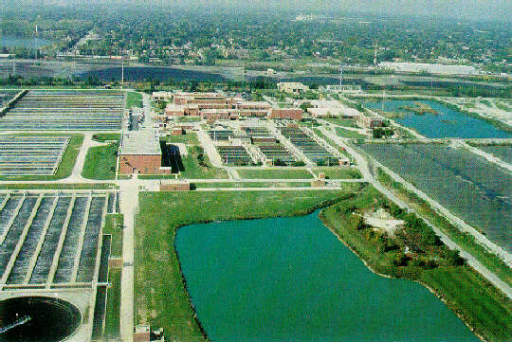
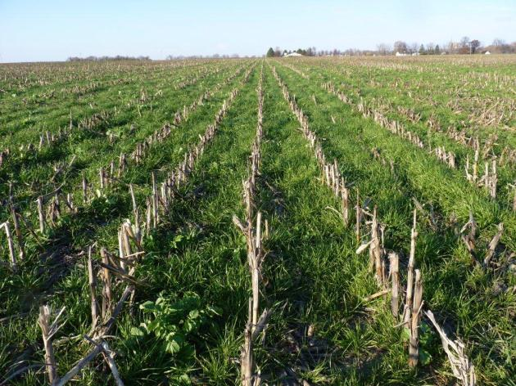
Science Assessment to Support an Illinois Nutrient Loss Reduction Strategy
Mark David, Greg McIsaac, George Czapar, Gary Schnitkey, Corey Mitchell
University of Illinois at Urbana-Champaign
November 13, 2013
11-08-12

Slide 2
Riverine N and P Fluxes
 | Water | Nitrate-N | Total N | DRP | Total P
 | 10¹² ft³ yr⁻¹ | million lb N or P yr⁻¹
David & Gentry (2000) | 1.6 |  | 538 |  | 31.3
1980-1996 | 1.70 | 404 | 527 | 15.4 | 34.0
1997-2011 | 1.72 | 410 | 536 | 18.5 | 37.5
Urban runoff |  | 6.0 | 8.3 |  | 1.5
Point sources |  | 75.2 | 87.3 |  | 18.1
 |  | Percent of 1997-2011 load
Point sources |  | 18.4 | 16.3 |  | 48
David & Gentry (2000) |  |  | 16 |  | 47

Slide 3
Illinois Nutrient Sources

Slide 4
Point and agricultural sources (1997-2011)

Slide 5
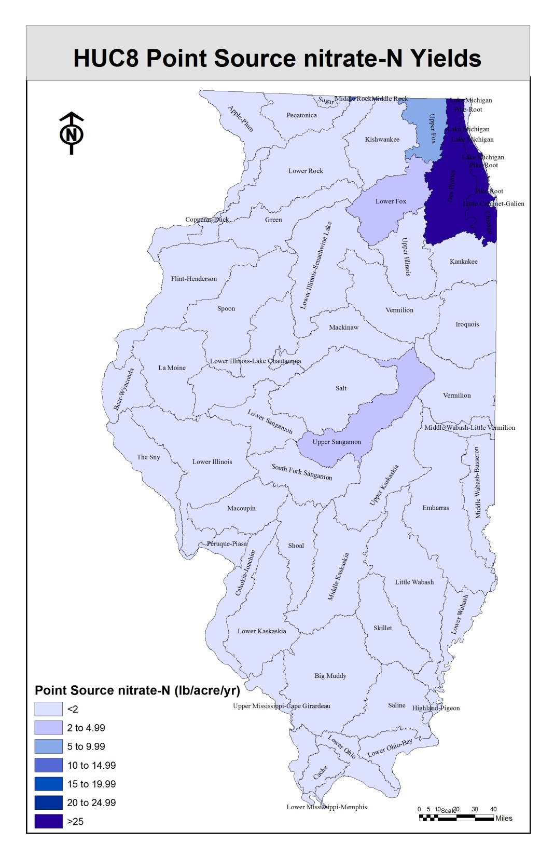
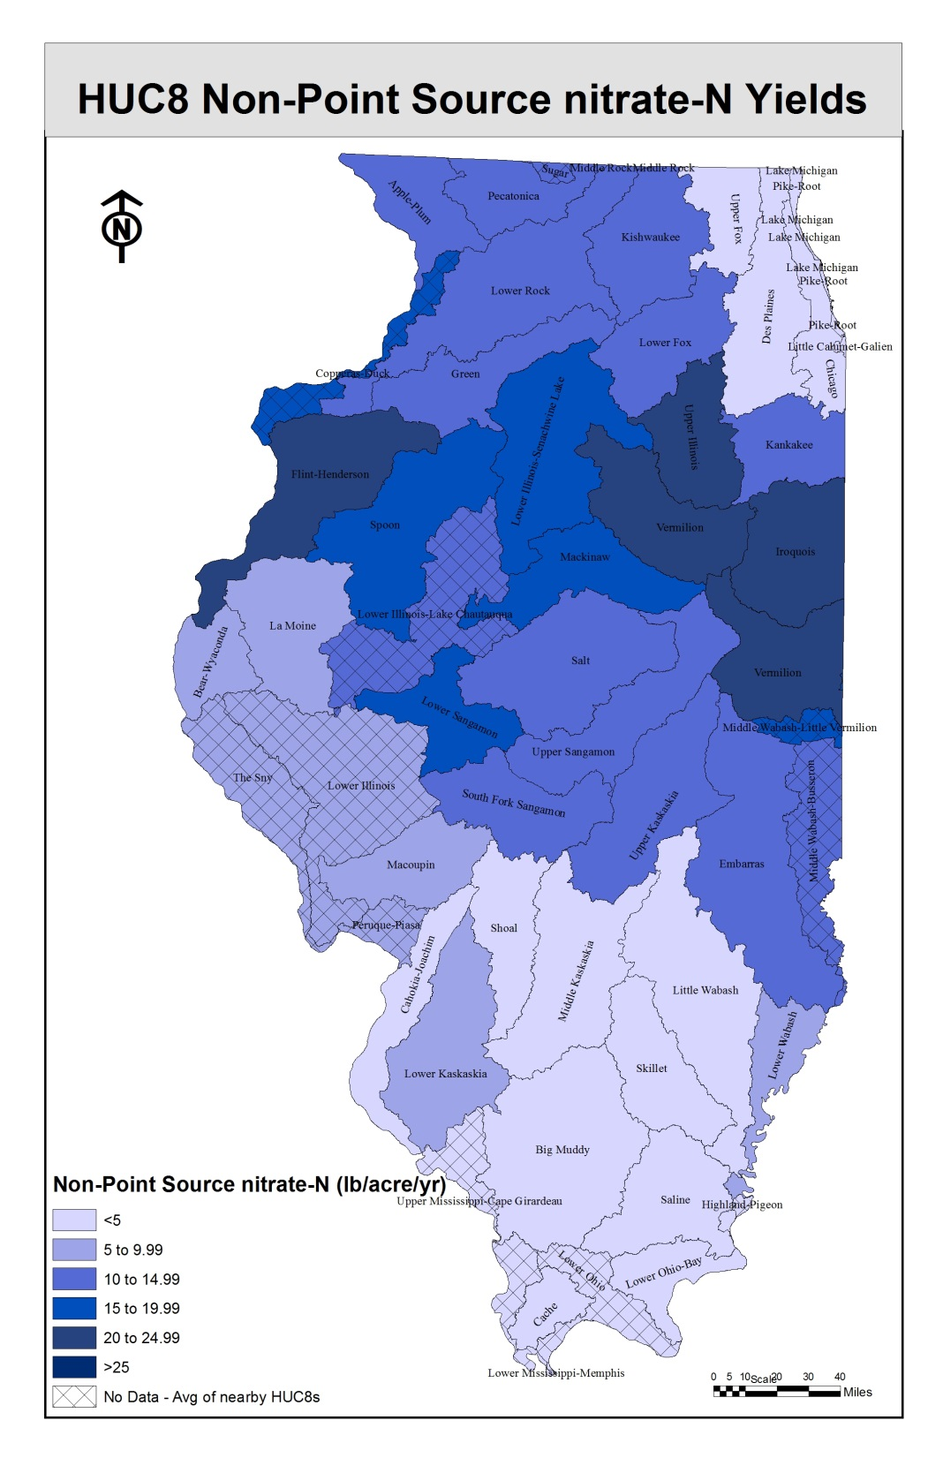

Slide 6
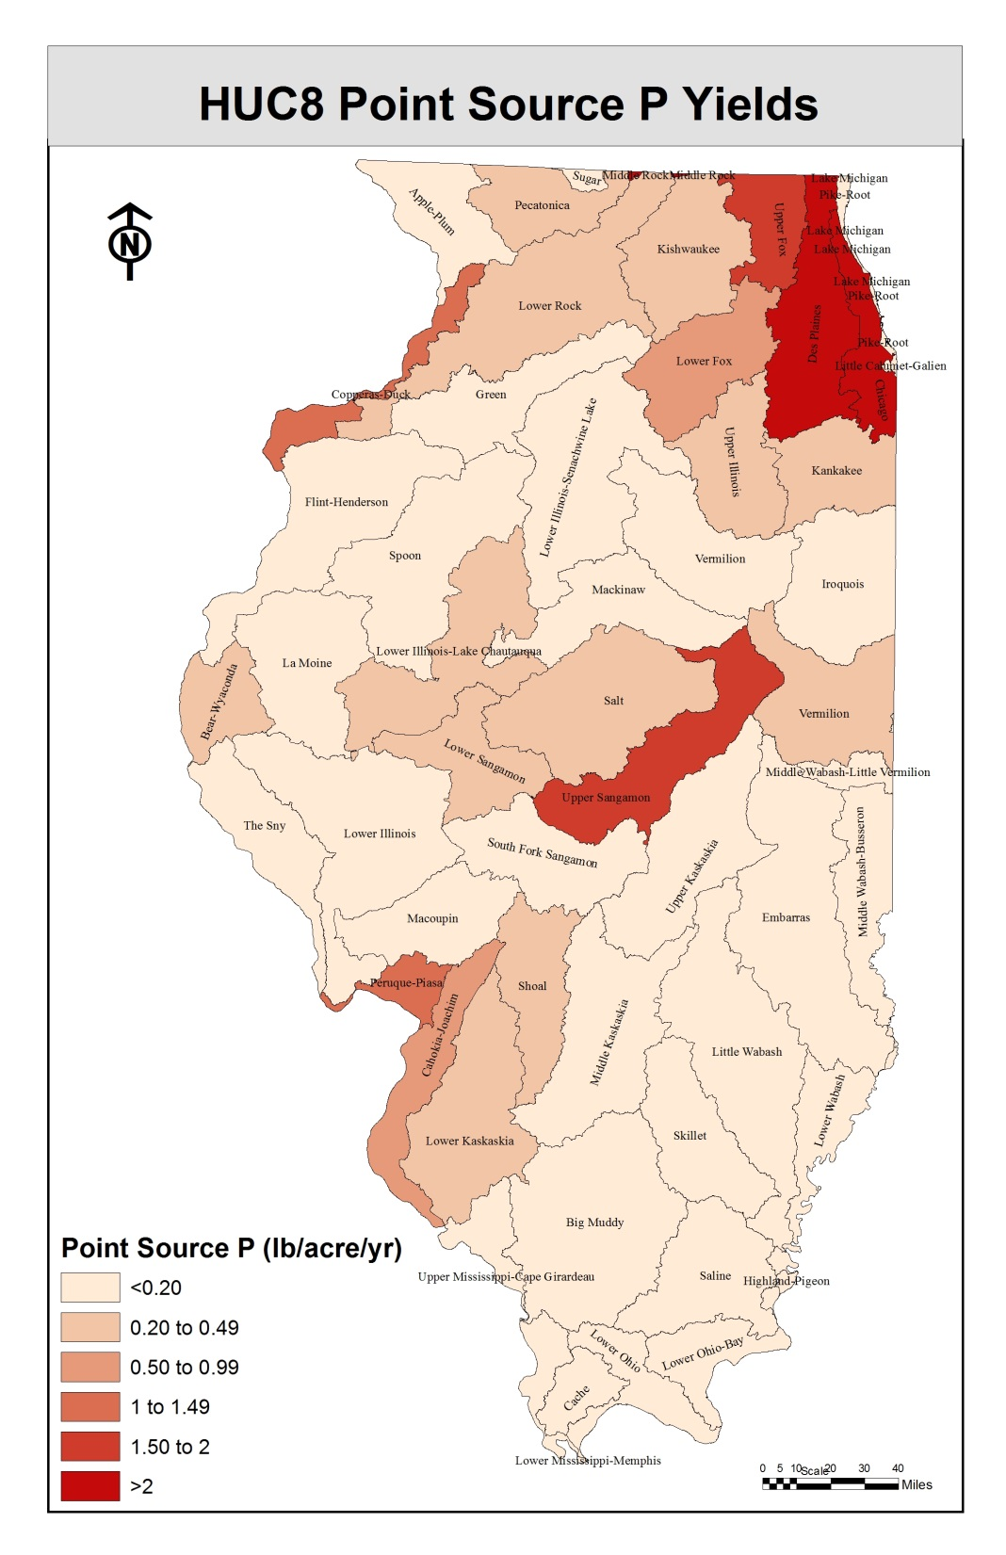
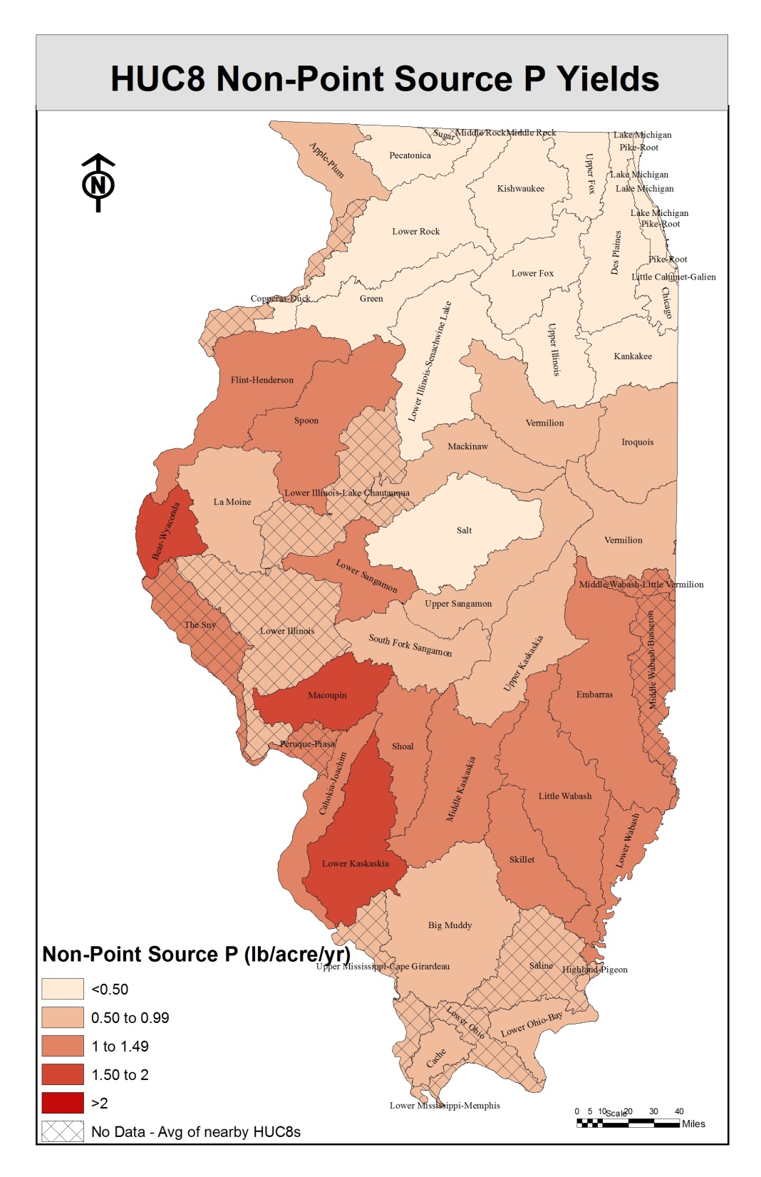

Slide 7
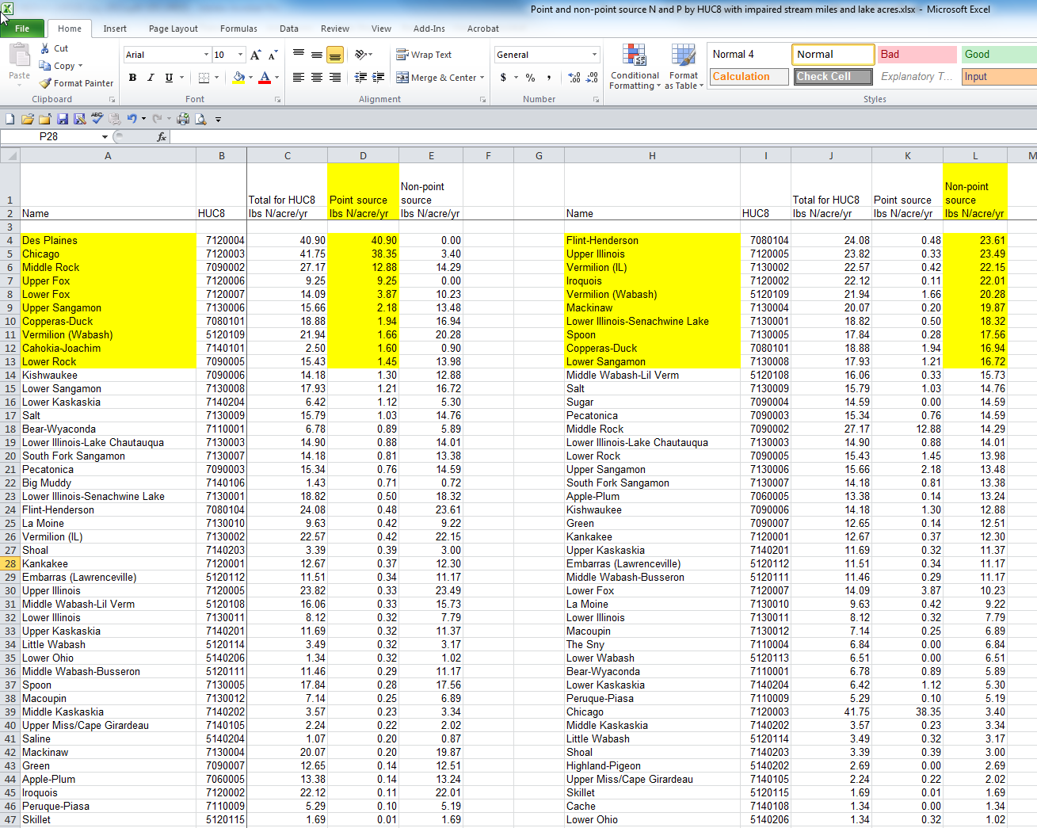

Slide 8
Nitrate-N and Total P Targets
Red line is target, purple is average 1997 to 2011

Slide 9
Point Source P Estimates
Point Source Limit (mg P/L) | million lb of P reduced | % of target (18.8 million lb P)
All majors to 1 mg/L standard (0.7 mg P/L actual) | 10.4 | 55
Top 20 majors to 0.7 | 6.1 | 32
Top 30 majors to 0.7 | 7.0 | 37
Top 50 majors to 0.7 | 7.8 | 41
All majors to 0.3 | 13.1 | 70
Top 20 majors to 0.3 | 8.0 | 42
Top 30 majors to 0.3 | 8.9 | 47
Top 50 majors to 0.3 | 9.9 | 52
Total P from point sources currently ~18.1 million lb P per year

Slide 10
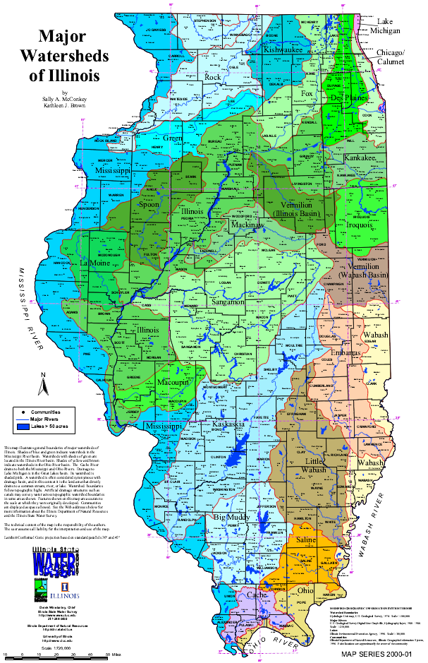
Possible intermediate reduction goal
30% total P reduction by 2025
top 50 majors reduce total P to 0.7 mg P/L (21%)
buffers and cover crops (9%)
20% nitrate-N reduction by 2025
fertilizer timing, cover crops, buffers, and bioreactors (20%)
to Gulf of Mexico

Slide 11
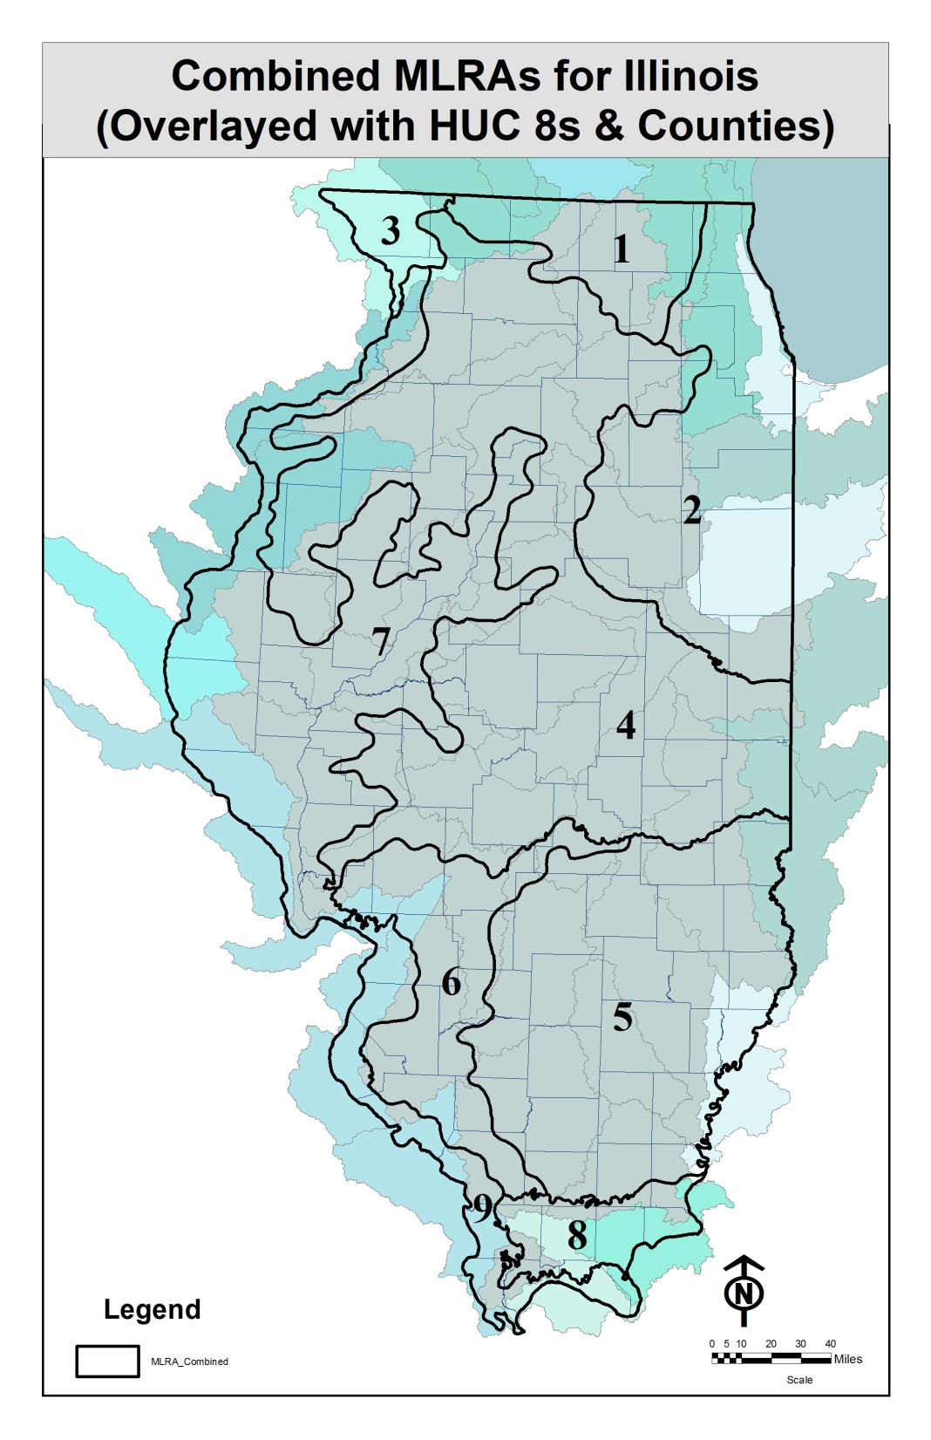

Slide 12
Nitrate Yield by MLRA
Combined MLRA | Description | Drained cropland (acres) | Nitrate-N yield per row crop acre (lb N/acre/yr) | Nitrate-N yield per tile drained acre (lb N/acre/yr) | Nitrate-N yield from non-tiled land (lb N/acre/yr)
MLRA 1 | Northern Illinois drift plain | 288,491 | 20.4 | 43 | 6.6
MLRA 2 | Northeastern Illinois heavy till plain | 2,063,695 | 25.0 | 29 | 10.8
MLRA 3 | Northern Mississippi Valley | 20,942 | 31.3 |  | 31.3
MLRA 4 | Deep loess and drift | 5,437,807 | 19.6 | 26 | 9.9
MLRA 5 | Claypan | 310,087 | 6.6 |  | 6.6
MLRA 6 | Thin loess and till | 226,971 | 7.4 | 30 | 3.5
MLRA 7 | Central Mississippi Valley, Northern Part | 1,284,588 | 24.5 | 46 | 11.8
MLRA 8 | Sandstone and shale hills and valleys | 49,565 | 3.9 |  | 3.9
MLRA 9 | Central Mississippi Valley, Western Part | 23,769 | 4.0 |  | 4.0

Slide 13
Cost analysis
Gary Schnitkey
agricultural costs per acre
Mark David
point source costs
N loss reduction costs
Greg McIsaac
P loss reduction costs

Slide 14
Agricultural Cost Estimates
No changes in corn and soybean yields across scenarios
No reduction in nitrogen application rates with timing changes
Up front costs amortized over 20 years at 6% interest rate

Slide 15
Costs per acre
 | Practice/Scenario | Cost Per Acre | Notes
 | Reducing N rate from background to the MRTN (10% of acres) | -$8 | Reduce N rates (20 pounds)
 | Nitrification inhibitor with all fall applied fertilizer on tile-drained corn acres | $7 | Cost of inhibitor
 | Split (50%) fall and spring (50%) on tile-drained corn acres | $17 | Additional field pass, switch to N solutions
 | Fall to spring on tile-drained corn acres | $18 | Switch to N solutions, higher ammonia price, additional application costs
 | Cover crops on all corn/soybean tile-drained acres | $29 | Aerial applications of cereal rye
 | Cover crops on all corn/soybean non-tiled acres | $29 | Aerial applications of cereal rye
 | Bioreactors on 50% of tile-drained land | $17 | Upfront costs of $133 per acre
 | Wetlands on 25% of tile-drained land | $60 | 5% of farmland out of production Major cost is land ($11,000)
 | Buffers on all applicable crop land (reduction only for water that interacts with active area) | $294 per buffer acre | Land costs plus $50 planting, $10 yearly maintenance
 | Perennial/energy crops equal to pasture/hay acreage from 1987 | $86 | Less profit compared to corn-soybean rotation
 | Perennial/energy crops on 10% of tile-drained land | $86 | Less profit compared to corn-soybean rotation
In-field
Edge-of-field
Land use change

Slide 16
P Reduction Practices
Reduce tillage: -$16 per acre
One less field pass
Eliminate P application for six years: -$15 per acre
Eliminate 6 years of applications, spread over 20 years to draw down P reserves
Incorporate P: $6 per acre
Additional application costs

Slide 17
Point Source Costs
dependent on size of facility
costs >>>> for smaller STP’s (< 1-2 MGD)
great variability among STP’s
used data from:
North Shore Sanitary District
three plant cost analysis
USEPA 2008 Municipal Nutrient Removal Technologies report
eight plant case study
more data to come, cost per lb likely to increase

Slide 18
Point Source Cost Summary (more estimates to be added)
Median $2.92/lb P $1.72 lb/N

Slide 19
Example Statewide Results for N
 | Practice/Scenario | Nitrate-N reduction per acre (%) | Nitrate-N reduced (million lb N) | Nitrate-N Reduction % (from baseline) | Cost ($/lb N removed)
 | Baseline |  | 410
 | Reducing N rate from background to the MRTN (10% of acres) | 10 | 2.3 | 0.6 | -4.25
 | Nitrification inhibitor with all fall applied fertilizer on tile-drained corn acres | 10 | 4.3 | 1.0 | 2.33
 | Split (50%) fall and spring (50%) on tile-drained corn acres | 7.5 to 10 | 13 | 3.1 | 6.22
 | Fall to spring on tile-drained corn acres | 15 to 20 | 26 | 6.4 | 3.17
 | Cover crops on all corn/soybean tile-drained acres | 30 | 84 | 20.5 | 3.21
 | Cover crops on all corn/soybean non-tiled acres | 30 | 32 | 7.9 | 11.33
 | Bioreactors on 50% of tile-drained land | 40 | 56 | 13.6 | 1.38
 | Wetlands on 25% of tile-drained land | 40 | 35 | 8.5 | 4.05
 | Buffers on all applicable crop land (reduction only for water that interacts with active area) | 90 | 36 | 8.7 | 1.63
 | Perennial/energy crops equal to pasture/hay acreage from 1987 | 90 | 10 | 2.5 | 9.72
 | Perennial/energy crops on 10% of tile-drained land | 90 | 25 | 6.1 | 3.18
 | Point source reduction to 10 mg nitrate-N/L |  | 14 | 3.4 | 1.72
 | Point source reduction in N due to biological nutrient removal for P |  | 8 | 1.8
In-field
Edge-of-field
Land use change
Point source

Slide 20
Example Statewide Results for P
 | Practice/Scenario | Total P reduction per acre (%) | Total P reduced (million lb P) | Total P Reduction % (from baseline) | Cost ($/lb P removed)
 | Baseline |  | 37.5
 | Convert 1.8 million acres of conventional till eroding >T to reduced, mulch or no-till | 50 | 1.8 | 5.0 | -16.60
 | P rate reduction on fields with soil test P above the recommended maintenance level | 7 | 1.9 | 5.0 | -97.50
 | Cover crops on all corn/soybean acres | 30 | 5.7 | 15.2 | 109.40
 | Cover crops on 1.6 million acres eroding>T currently in reduced, mulch or no-till | 50 | 1.9 | 5.0 | 24.50
 | Incorporation of all P fertilizers | 25 | Unknown area | Unknown
 | Wetlands on 25% of tile-drained land | 0 | 0 | 0.0
 | Buffers on all applicable crop land | 25-50 | 4.8 | 12.9 | 11.97
 | Perennial/energy crops equal to pasture/hay acreage from 1987 | 90 | 1.0 | 2.7 | 93.59
 | Perennial/energy crops on 1.6 million acres>T currently in reduced, mulch or no-till | 90 | 3.5 | 9.0 | 40.40
 | Perennial/energy crops on 10% of tile-drained land | 50 | 0.3 | 0.8 | 250.07
 | Point source reduction to 0.5 mg total P/L |  | 11.7 | 31.2 | 2.92
In-field
Edge-of-field
Land use change
Point source

Slide 21
University of Illinois Science Team Website
http://biogeochemistry.nres.illinois.edu/Biogeochem_lab/Illinois_Science_Assessment.html

Slide 22
Iowa Costs

Slide 23
Overall Comparison of Nitrate-N Practices
 | Nitrate-N Reduction | Cost of N Reduction | Other Benefits (Ecosystem Services)
Practice/Scenario | % (from baseline) | ($/lb)
Reducing nitrogen application rate from background to the MRTN | 9 | -0.58
Cover crops (rye) on ALL CS and CC acres | 28 | 5.96 | ++
Install Wetlands to treat 45% of the ag acres | 22 | 1.38 | ++
Install Denitrification Bioreactors on all tile drained acres | 18 | 0.92
Install Buffers on all applicable lands | 7 | 1.91 | ++
Installing Controlled Drainage on all applicable acres | 2 | 1.29
Perennial crops (energy crops) on ~6.5 million acres | 18 | 21.46 | ++

Slide 24
Overall Comparison of Phosphorus Practices
 | P Reduction | Cost of P Reduction | Other Benefits (Ecosystem Services)
Practice/Scenario | % (from baseline) | ($/lb)
Cover crops (rye) on ALL CS and CC acres | 50 | 60 | ++
Convert all tillage to no-till | 39 | 14 | ++
P rate reduction in MLRA’s that have high to very high soil test P | 7 | -110
Establish streamside buffers (35ft) on all crop land | 18 | 14 | ++
Perennial crops (energy crops) equal to pasture/hay acreage from 1987 | 29 | 238 | ++
Pasture and Land Retirement to equal acreage of Pasture/Hay and CRP from 1987 | 9 | 120 | ++

